Slide 1
Energy review

Slide 2
What is energy?
The ability to do work or make change in matter.

Slide 3
Energy comes in what 2 main types?
Kinetic and Potential

Slide 4
What is potential energy?
Stored energy due to its height or position.

Slide 5
These two things affect the amount of potential energy.
Mass and height

Slide 6
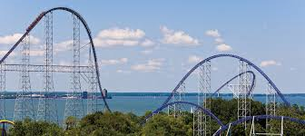
When does a roller coaster car have the most potential energy?
At the first/highest hill

Slide 7
What is kinetic energy?
Energy of motion

Slide 8
What two things affect the amount of kinetic energy in an object?
Mass and speed

Slide 9
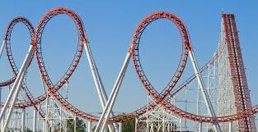
When does a roller coaster have the most kinetic energy?
At the bottom of the highest hill

Slide 10
What type of potential energy do the following pictures have?

Slide 11

GRAVITATIONAL

Slide 12
eLASTIC

Slide 13
NUCLEAR

Slide 14
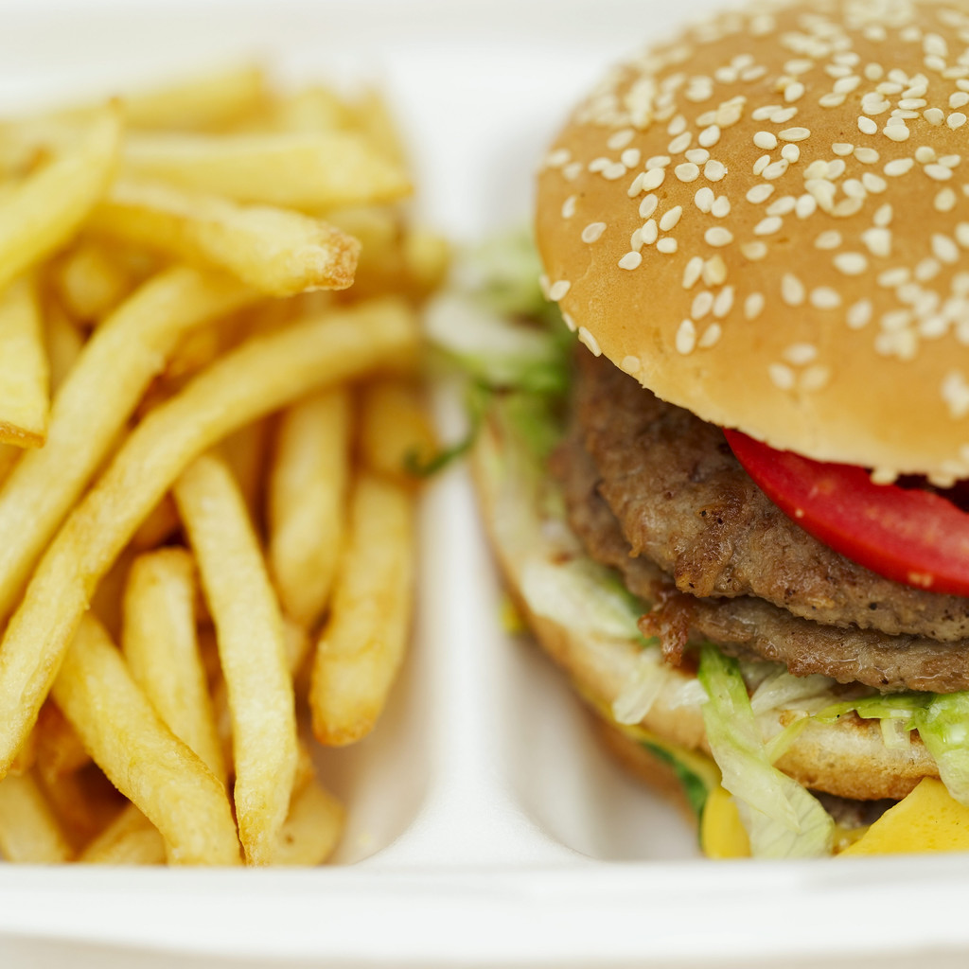
Chemical

Slide 15

Elastic

Slide 16
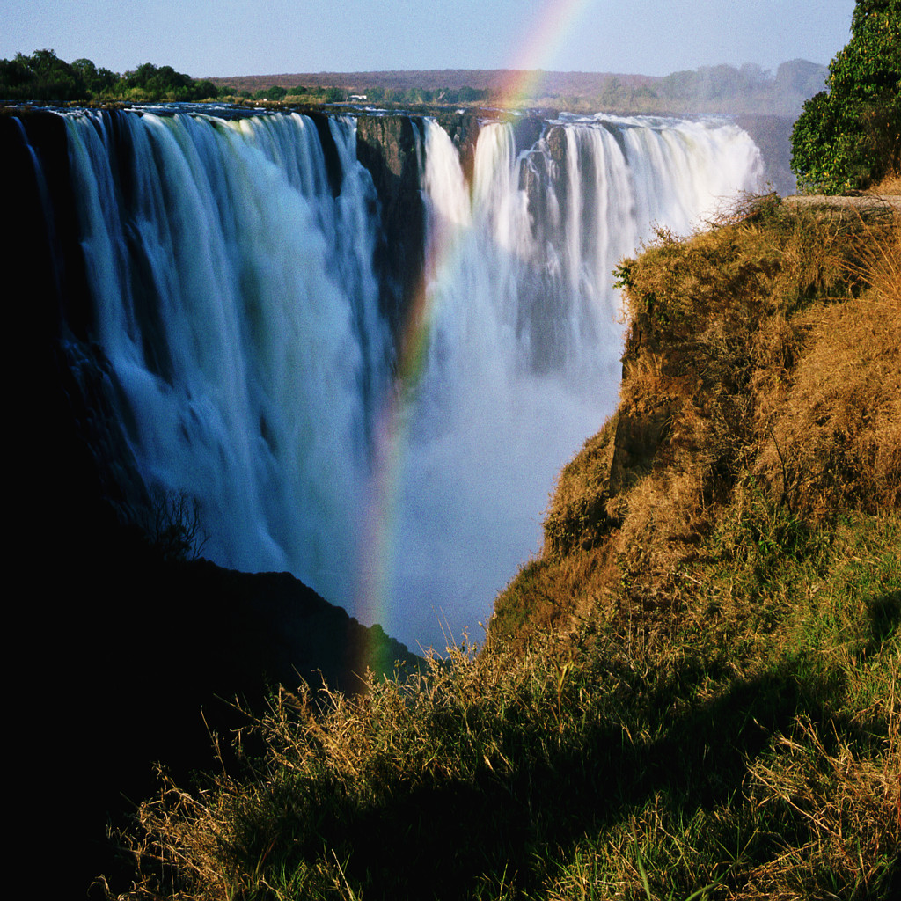
Gravitational

Slide 17
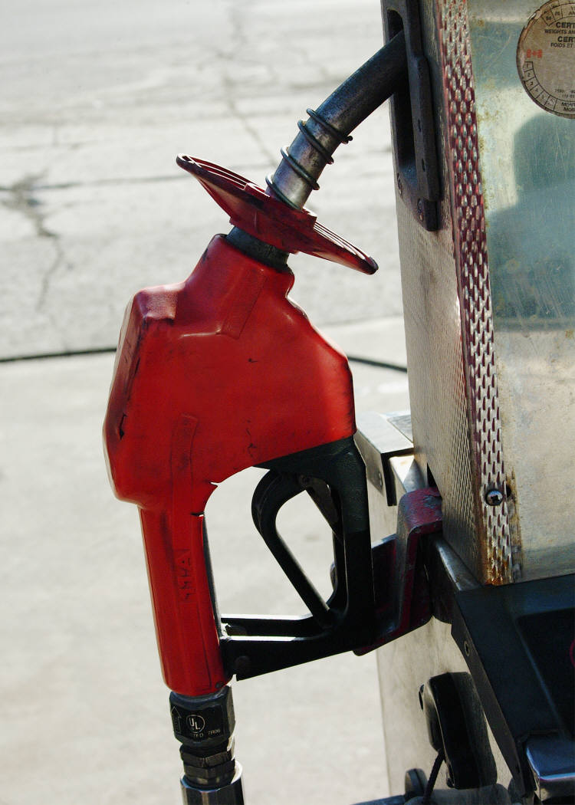
Chemical

Slide 18
What type of kinetic energy do the following pictures show?

Slide 19

Electrical

Slide 20

Sound energy

Slide 21
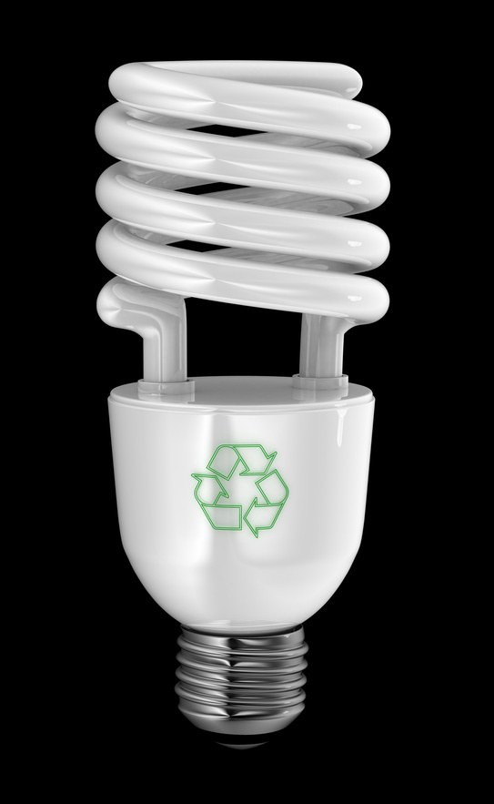
Radiant energy

Slide 22
Motion energy

Slide 23

Thermal energy

Slide 24
Motion energy

Slide 25
Sound energy

Slide 26
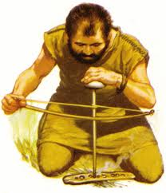
Thermal energy

Slide 27
Electrical energy

Slide 28
Radiant energy

Slide 29
This states that energy is not created or destroyed.
The Law of Conservation of Energy

Slide 30
What is it called when energy changes form?
Energy Transformation

Slide 31
What energy transformations are taking place in the following pictures?

Slide 32
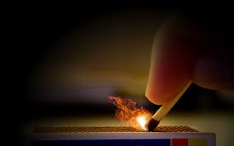
Chemical → Thermal

Slide 33



Chemical → Mechanical / Motion

Slide 34

Chemical → Motion → Sound → Radiant

